Slide 1

Plug n Play Clusters
Making big data processing easy

Slide 2
Our Team
Amandeep Singh (101503023)
Ameetpal Singh (101683036)
Jagjeet Singh (101683010)
Our Mentor
Dr. Sukhchandan Randhawa

Slide 3
Contents
Overview
Need analysis
Proposed system
Working methodology
Compatibility

Slide 4
Overview
Building a easy to use multi node clustering System.
The proposed system can be used by anyone with minimal javascript knowledge.
Easy to setup.

Slide 5
Need analysis
Setting up hadoop is a difficult process.
Require good knowledge of various frameworks like YARN, HDFS.

Slide 6
Proposed system
Using client server architecture to do multinode clustering.
Browsers act as slaves and server act as master.
Any device which have a web browser can act as slave.
.

Slide 7
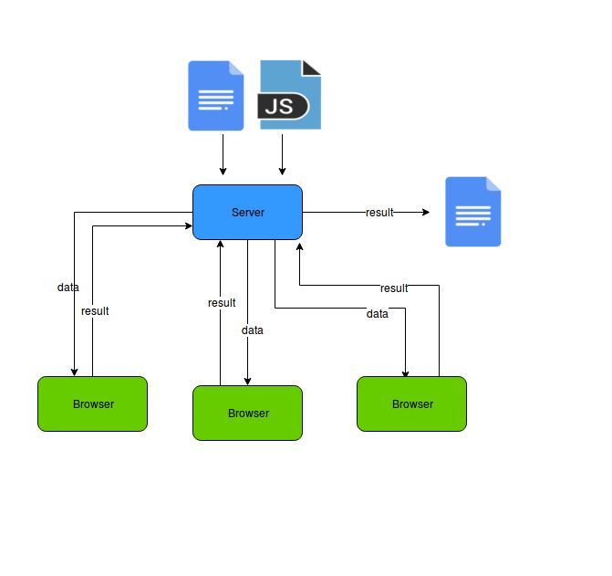
Working methodology
Notes:
Intelligent tutoring System

Slide 8
Working methodology
Server
Split given file into small files (44MB).
Dynamically render webpage according to given javascript file.
Send small file to the browser.
Collect result from the browser.
Merge all files into a single file.
.

Slide 9
Working methodology
Browser
Open Website.
Ask for Data.
Process the file obtained from server.
Send results back.
Ask for more data to process.
.

Slide 10
Technologies Used
Nodejs
Reactjs
MySql
Redux
Socket.Io
Postman
Selenium
Notes:
Intelligent tutoring System

Slide 11
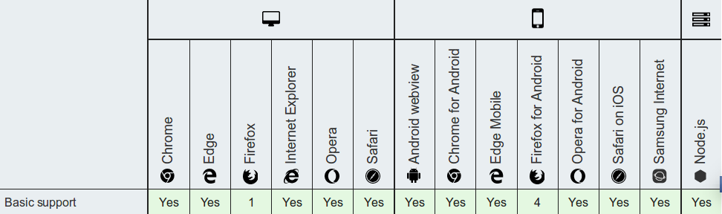
Compatible Devices
Notes:
Intelligent tutoring System

Slide 12
Thank you

